Slide 1

Algorithm Design and Analysis

Slide 2
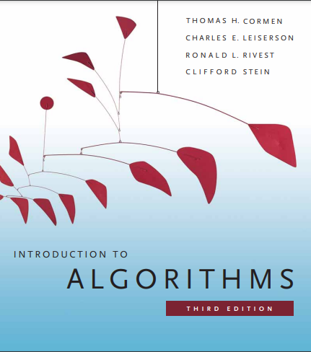
Algorithm Design and Analysis

Slide 3
Chapter 6: Elementary Graph terminologies and algorithms

Slide 4
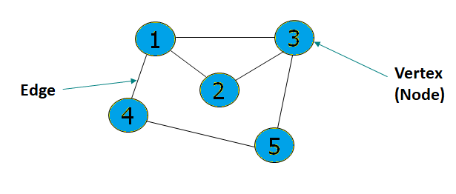
What is Graph?
A Graph is a data structure which consists of a set of vertices, and a set of edges that connect (some of) them.
That is, G = (V, E), Where V - set of vertices, E - set of edges
V = {1, 2, 3, 4, 5}
E = { (1,2), (1,3), (1,4), (2,3), (3,5), (4,5) }

Slide 5
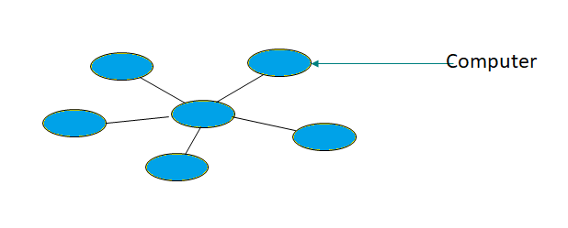
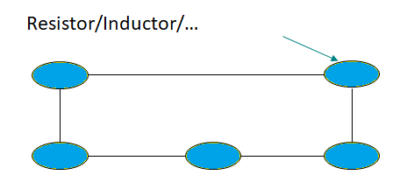
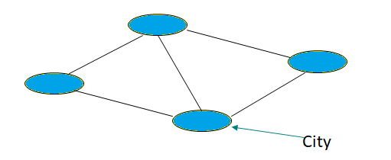
Some Applications
Computer Networks
Electrical Circuits
Road Map

Slide 6
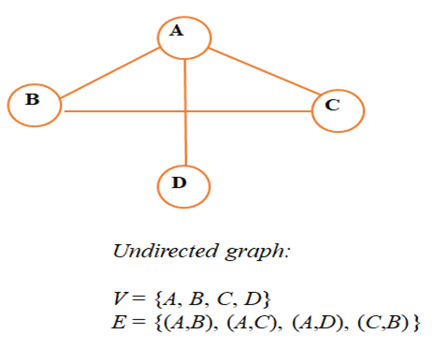
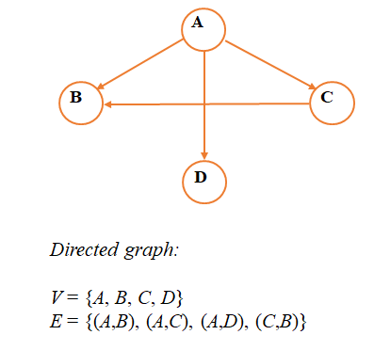
Graph Categorization
1- Directed graph or Digraph: is a graph where each edge has a direction
    The edges in a digraph are called Arcs or Directed Edges
2- Undirected graph: is a graph where the edges have no directions
    The edges in an undirected graph are called Undirected Edges

Slide 7
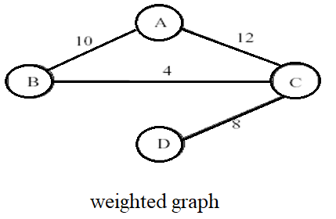
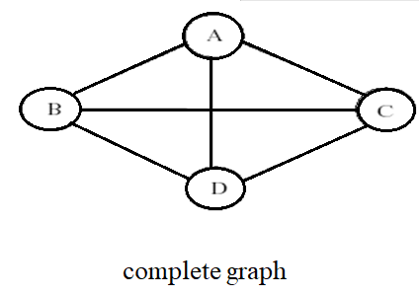
Cont …..
3- Weighted graph: is a graph where each edge carries a value
  A weighted graph is a graph G = (V, E, W), where each edge, e ∈ E is assigned a real valued weight, W(e).
4- Complete graph: is a graph with an edge between every pair of vertices.
  A graph is called complete graph if every vertex is adjacent to every other vertex.

Slide 8
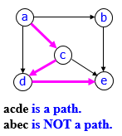
Graph Terminology
Adjacent vertices: connected by an edge
  Vertex v is adjacent to u if and only if (u, v) ∈ E.
  In an undirected graph with edge (u, v), and hence (v, u), v is adjacent to u and u is adjacent to v.
a
b
a
b
c
c
d
e
d
e
Vertex a is adjacent to c and
Vertex c is adjacent to a
Vertex c is adjacent to a, but
Vertex a is NOT adjacent to c
A Path is a sequence of edges in the graph
  There can be more than one path between two vertices. Paths from a to e
  - One path → a, b, e
  - Another path → a, c, d, e
  Vertex u is reachable from v if there is a path from v to u.
Length of a path is the sum of the lengths of the edges on the path.
  Length of the path a,c,d,e is 3

Slide 9
Cont…..
A simple path is a path such that all vertices are distinct.
1,4,5,3 is a simple path.
But 1,4,5,4 is not a simple path.
3
1
2
Circuit: A path whose first and last vertices are the same.
  The path 3,2,1,4,5,3 is a circuit.
Cycle: A circuit where all the vertices are distinct except for the first (and the last) vertex.
  1,4,5,3,1 is a cycle, but 1,4,5,4,1 is not a cycle.
4
5
1
3
Hamiltonian Cycle: A Cycle that contains all the vertices of the graph.
  1,4,5,3,2,1 is a Hamiltonian Cycle.
2
4
5
Loops or self edges: an edge (v , v) is called a self edge or a loop.
  ( 1,1 ) and ( 4,4 ) are self edges
1
Parallel edges
  Edges connecting same vertices . Graph that contains parallel edges said a Multigraph.
Simple graph
  Graph without loops or parallel edges
2
3

Slide 10
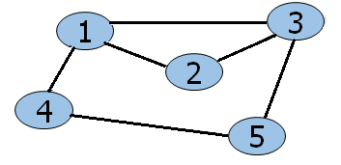
Cont…..
Degree of a Vertex: In an undirected graph, the number of edges incident to the vertex
  degree(1) = 3, degree(5) = 2
In-degree and out-degree of a Vertex: In a directed graph
  In-degree: the number of edges entering the vertex in a digraph
    In-degree of 1 is 3
  Out-degree: the number of edges leaving the vertex in a digraph
    Out-degree of 1 is 1
1
3
2
A Subgraph of graph G=(V,E) is a graph H=(U,F) such that U Є V and F Є E
4
5
3
1
3
1
3
1
1
2
2
2
2
4
4
4
5
5
H=(U,F)
G=(V,E)

Slide 11
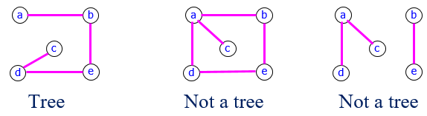
Cont…..
Connected graph: is the graph that has at least one path from every vertex to every other vertex in the graph.
1
3
1
3
2
2
4
4
5
5
Connected
Unconnected
Tree: a connected undirected graph that contains no cycles
1
3
2
Forest: a graph that does not contain a cycle
  Collection of trees
4
5
Forest

Slide 12
Representation of Graphs
1- Adjacency Matrix (A)
  The Adjacency Matrix A=(a_{i,j}) of a graph G=(V,E) with n nodes is an n x n matrix
  Each element of A is either 0 or 1, depending on the adjacency of the nodes
  a_{ij} = 1, if (i,j) Є E,
  a_{ij} = 0, otherwise
Example: Find the adjacency matrices of the following graphs.
1
3
0 | 1 | 0
0 | 0 | 1
1 | 1 | 0
2
0 | 1 | 1 | 1 | 0
1 | 0 | 1 | 0 | 0
1 | 1 | 0 | 0 | 1
1 | 0 | 0 | 0 | 1
0 | 0 | 1 | 1 | 0
1
3
2
4
5
  Adjacency Matrix of a Weighted Graph
    The weight of the edge can be shown in the matrix when the vertices are adjacent
    A nil value (0 or ∞) depending on the problem is used when they are not adjacent
    Example: To find the minimum distance between nodes...
9
∞ | 4 | ∞
∞ | ∞ | 5
9 | 5 | ∞
1
3
4
2
5

Slide 13
Cont…..
2- Adjacency List
  An Adjacency list is an array of lists, each list showing the vertices a given vertex is adjacent to….
3
2
1
3
1
1
1
2
2
1
3
2
2
4
3
1
5
4
4
5
4
1
5
5
5
Adjacency List of a Weighted Graph
  The weight is included in the list
9
1
2
4
1
3
2
3
5
4
2
5
3
1
9
2
5

Slide 14
Graph Searching Methods
Many graph problems solved using a search method
  Path from one vertex to another
  Is the graph connected?
Commonly used search methods:
  Breadth-first search (BFS)
  Depth-first search (DFS)
2
3
8
1
- A vertex u is reachable from vertex v iff there is a path from v to u.
- A search method starts at a given vertex v and visits every vertex that is reachable from v.
4
5
9
10
Graph Searching Method:
- Given: a graph G = (V, E), directed or undirected
- Goal: methodically explore every vertex and every edge
6
7
11

Slide 15
Breadth-First Search (BFS)
Starting from a given node s, BFS visit the vertices at distance d from s before visiting the vertices at distance d+1
Idea:
  Visit start vertex (s) and put into a queue (FIFO).
  Repeatedly remove a vertex from the queue, visit its unvisited adjacent vertices, put newly visited vertices into the queue.
  All vertices reachable from the start vertex (s) (including the start vertex) are visited.
Work Strategy:
Again will associate vertex “colors” to guide the algorithm
  White vertices have not been discovered
    All vertices start out white
  Gray vertices are discovered but not fully explored
    They may be adjacent to white vertices
  Black vertices are discovered and fully explored
    They are adjacent only to black and gray vertices
  Explore vertices by scanning adjacency list of gray vertices

Slide 16
BFS - Code
BFS(G, s) {
// initialize vertices;
1 for each u ∈ V(G) – {s}{
2 do color[u] = WHITE
3 d[u] = ∞ // distance from s to u
4 p[u] = NIL // predecessor or parent of u
}
5 color[s] = GRAY
6 d[s] = 0
7 p[s] = NIL
8 Q = Empty;
9 Enqueue (Q,s); // Q is a queue; initialize to s
10 while (Q not empty) {
11 u = Dequeue(Q);
12 for each v ∈ adj[u] {
13 if (color[v] == WHITE)
14 color[v] = GRAY;
15 d[v] = d[u] + 1;
16 p[v] = u;
17 Enqueue(Q, v);
}
18 color[u] = BLACK;
}
}
WHITE - Unvisited
GRAY - Discovered
BLACK - Finished
s - Source Vertex
Q - FIFO Queue

Slide 17
BFS - Example
r
s
t
u
∞
∞
∞
∞
∞
∞
∞
∞
v
w
x
y

Slide 18
BFS - Example
r
s
t
u
∞
0
∞
∞
∞
∞
∞
∞
v
w
x
y
S has two neighbors w and r
You can add r then w or w then r (depends on the adjacency list order!)
Q:
s

Slide 19
BFS - Example
r
s
t
u
1
0
∞
∞
∞
1
∞
∞
v
w
x
y
Q:
w
r

Slide 20
BFS - Example
r
s
t
u
1
0
2
∞
∞
1
2
∞
v
w
x
y
Q:
r
t
x

Slide 21
BFS - Example
r
s
t
u
1
0
2
∞
2
1
2
∞
v
w
x
y
Q:
t
x
v

Slide 22
BFS - Example
r
s
t
u
1
0
2
3
2
1
2
∞
v
w
x
y
Q:
x
v
u

Slide 23
BFS - Example
r
s
t
u
1
0
2
3
2
1
2
3
v
w
x
y
Q:
v
u
y

Slide 24
BFS - Example
r
s
t
u
1
0
2
3
2
1
2
3
v
w
x
y
Q:
u
y

Slide 25
BFS - Example
r
s
t
u
1
0
2
3
2
1
2
3
v
w
x
y
Q:
y

Slide 26
BFS - Example
r
s
t
u
1
0
2
3
2
1
2
3
v
w
x
y
Q:
Ø

Slide 27
BFS: Time complexity
BFS(G, s) {
// initialize vertices
for each u ∈ V(G) – {s}{
do color[u] = WHITE
d[u] = ∞
p[u] = NIL
}
color[s] = GRAY;
d[s] = 0;
p[s] = NIL;
Q = Empty;
Enqueue (Q,s);
while (Q not empty) {
u = Dequeue(Q);
for each v ∈ adj[u] {
if (color[v] == WHITE)
color[v] = GRAY;
d[v] = d[u] + 1;
p[v] = u;
Enqueue(Q, v); }
color[u] = BLACK; } }
Touch every vertex: O(V)
u = every vertex, but only once
So v = every vertex that appears in some other vert’s adjacency list
O(E)
What will be the running time?
Total running time: O(V+E)

Slide 28

BFS: Time Complexity
Given a graph G = (V, E)
  Vertices are enqueued if there color is white
  Assuming that en- and dequeuing takes O(1) time the total cost of this operation is O(V)
  Adjacency list of a vertex is scanned when the vertex is dequeued (and at most once)
  The sum of the lengths of all lists is Ο(E). Consequently, O(E) time is spent on scanning them
  Initializing the algorithm takes O(V)
Total running time O(V+E)
  linear in the size of the adjacency list representation of G
What will be the storage cost in addition to storing the tree?

Slide 29
Depth-First Search (DFS)
DFS is another strategy for exploring a graph
Idea:
  Explore “deeper” in the graph whenever possible
  Edges are explored out of the most recently discovered vertex v that still has unexplored edges
  When all of v’s edges have been explored, backtrack to the vertex from which v was discovered
Work Strategy:
  Initialize
    Color all vertices white
  Visit each and every white vertex using DFS-Visit
  Each call to DFS-Visit(u) roots a new tree of the depth-first forest at vertex u
  A vertex is white if it is undiscovered
  A vertex is gray if it has been discovered but not all of its edges have been discovered
  A vertex is black after all of its adjacent vertices have been discovered (the adj. list was examined completely)

Slide 30
DFS - Code
DFS(G)
{
for each vertex u ∈ V[G]
{
color[u] = WHITE;
p[u] = NIL;
}
time = 0;
for each vertex u ∈ V[G]
{
if (color[u] == WHITE)
DFS_Visit(u);
}
}
DFS_Visit(u)
{
color[u] = GRAY;
time = time+1;
d[u] = time;
for each v ∈ Adj[u]
{
if (color[v] == WHITE)
p[v] = u;
DFS_Visit(v);
}
color[u] = BLACK;
time = time+1;
f[u] = time;
}
// Initialize all vertices
// Visit all children recursively

Slide 31
DFS - Example
source
vertex

Slide 32
DFS Example
source
vertex
d f
1 |
|
|
|
|
|
|
|

Slide 33
DFS Example
source
vertex
d f
1 |
|
|
2 |
|
|
|
|

Slide 34
DFS Example
source
vertex
d f
1 |
|
|
2 |
|
3 |
|
|

Slide 35
DFS Example
source
vertex
d f
1 |
|
|
2 |
|
3 | 4
|
|

Slide 36
DFS Example
source
vertex
d f
1 |
|
|
2 |
|
3 | 4
5 |
|

Slide 37
DFS Example
source
vertex
d f
1 |
|
|
2 |
|
3 | 4
5 | 6
|

Slide 38
DFS Example
source
vertex
d f
1 |
8 |
|
2 | 7
|
3 | 4
5 | 6
|

Slide 39
DFS Example
source
vertex
d f
1 |
8 |
|
2 | 7
9 |
3 | 4
5 | 6
|
What is the structure of the gray vertices?
What do they represent?

Slide 40
DFS Example
source
vertex
d f
1 |
8 |
|
2 | 7
9 |10
3 | 4
5 | 6
|

Slide 41
DFS Example
source
vertex
d f
1 |
8 |11
|
2 | 7
9 |10
3 | 4
5 | 6
|

Slide 42
DFS Example
source
vertex
d f
1 |12
8 |11
|
2 | 7
9 |10
3 | 4
5 | 6
|

Slide 43
DFS Example
source
vertex
d f
1 |12
8 |11
13|
2 | 7
9 |10
3 | 4
5 | 6
|

Slide 44
DFS Example
source
vertex
d f
1 |12
8 |11
13|
2 | 7
9 |10
3 | 4
5 | 6
14|

Slide 45
DFS Example
source
vertex
d f
1 |12
8 |11
13|
2 | 7
9 |10
3 | 4
5 | 6
14|15

Slide 46
DFS Example
source
vertex
d f
1 |12
8 |11
13|16
2 | 7
9 |10
3 | 4
5 | 6
14|15

Slide 47
Depth-First Search: The Code
DFS_Visit(u)
{
color[u] = GRAY;
time = time+1;
d[u] = time;
for each v ∈ Adj[u]
{
if (color[v] == WHITE)
p[v] = u;
DFS_Visit(v);
}
color[u] = BLACK;
time = time+1;
f[u] = time; }
DFS(G)
{
for each vertex u ∈ V[G]
{
color[u] = WHITE;
p[u] = NIL
}
time = 0;
for each vertex u ∈ V[G]
{
if (color[u] == WHITE)
DFS_Visit(u);
}
}
Θ(V)
How many times will DFS_Visit() actually be called? Θ(V)
How many times will if statement be executed in all O(V) DFS_Visit calls? Θ(E)
So, running time of DFS = Θ(V+E)

Slide 48
DFS: Time Complexity
Running time
  the loops in DFS take time Θ(V) each, excluding the time to execute DFS-Visit
  DFS-Visit is called once for every vertex
    its only invoked on white vertices, and
    paints the vertex gray immediately
  for each DFS-Visit(v) a loop iterates over all Adj[v]
  the total cost for DFS-Visit is Θ(E)
  the running time of DFS is Θ(V+E)

